Slide 1





Comprehensive Analysis of Term Deposit Subscriptions by training ML model
Insights and Predictions Across Demographics and Financial Behaviors
Hemalatha Kasthuri
Student code: fd39_144
LinkedIn id
Aman Shaikh
Student code: fd39_192
LinkedIn id
Shakeb Mustak Patel
Student code: fd38_700
LinkedIn id

Slide 2
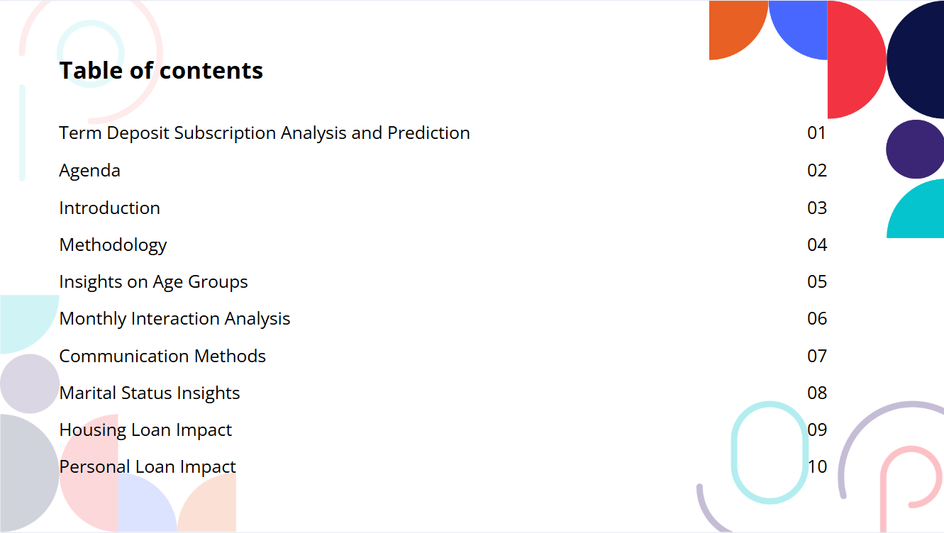

Slide 3
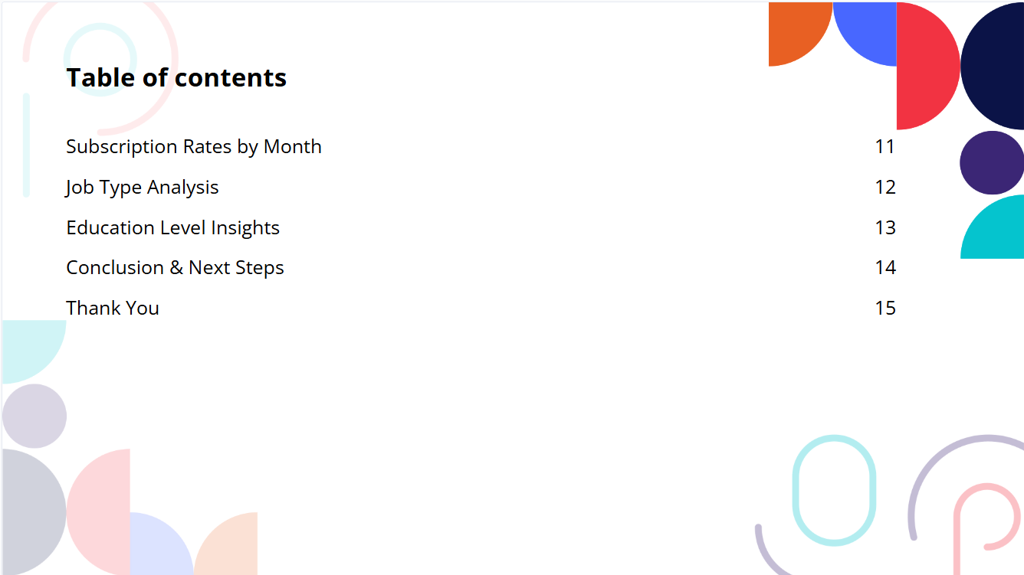

Slide 4

Term Deposit Subscription Analysis and Prediction
Objective of the Analysis: Analyze the effectiveness of telemarketing campaigns conducted by a Portuguese bank to promote term deposits.
Key Insights: Older age groups tend to have higher average balances, indicating a greater likelihood to subscribe to term deposits. August has the highest subscription rate (18.25%), followed by June (10.23%) and October (8.42%). Cellular communication is the most effective method for customer contact (83.88%).
Target Demographics: High-potential groups identified include Management, Retired individuals, and Technicians.
Financial Considerations: A significant portion of customers (78.91%) do not have housing loans, suggesting they may have more disposable income for term deposits.

Slide 5





AGENDA
Introduction
Methodology
Insights and findings
Conclusion

Slide 6
Introduction
Objective of the Project
Importance of Term Deposits
Methodological Approach
This project focuses on evaluating the effectiveness of telemarketing campaigns conducted by a prominent Portuguese bank aimed at promoting term deposits.
Our primary goal is to enhance marketing strategies to improve both customer acquisition and retention rates.
Term deposits play a vital role in the financial stability of banks, providing a steady stream of income.
Identifying customer segments that are more likely to invest in term deposits can significantly enhance marketing efficiency.
Understanding the importance of term deposits helps in tailoring marketing strategies to meet customer needs effectively.
Utilize advanced data analytics techniques to identify key trends and insights from historical campaign data.
Implement machine learning algorithms to predict customer responses and optimize targeting strategies for future campaigns.
Conduct A/B testing to evaluate the effectiveness of different marketing approaches and refine messaging accordingly.

Slide 7
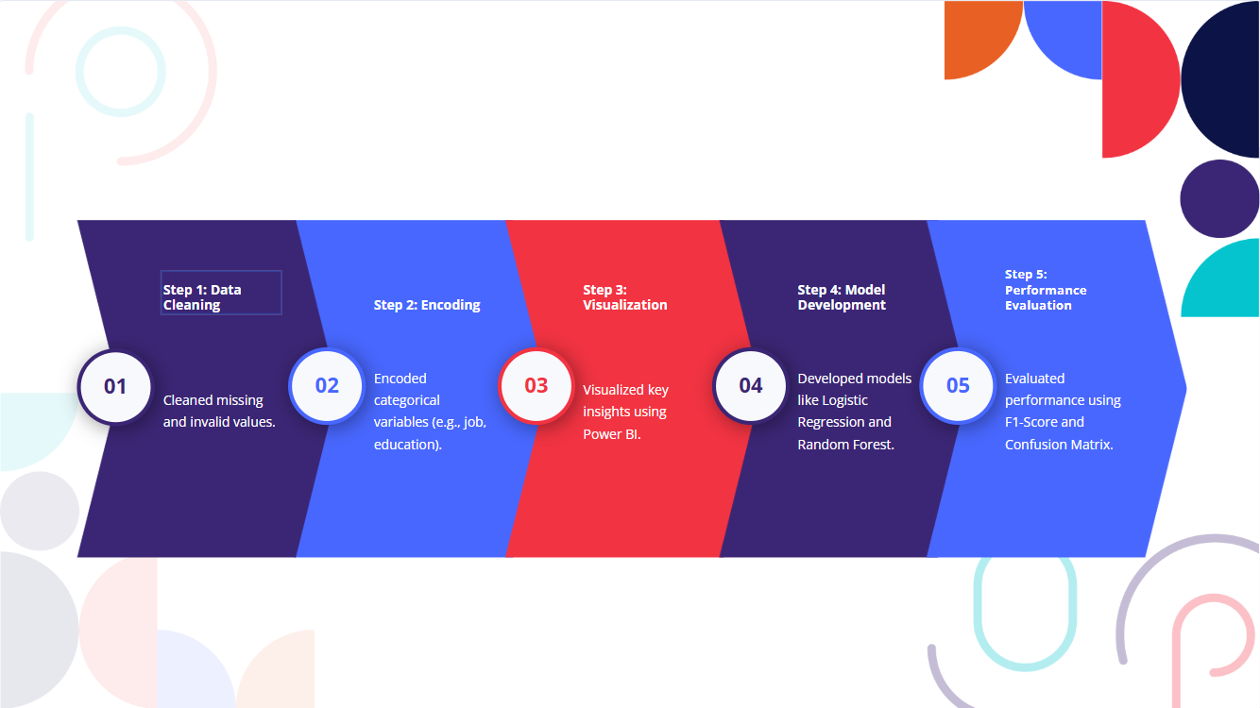
Methodology

Slide 8

Used softwares and files to train ML model
CSV file (train.csv and test.csv)
Jupiter Notebook to execute python code
Random forest, linear regression, Label encoder was used in this project to train ML model
Power-bi to generate insights and to perform EDA

Slide 9
Insights on Age Groups
Older individuals generally have higher account balances due to accumulated wealth and savings.
They are more knowledgeable about financial products, making them likely to invest in term deposits for security.
As retirement approaches, older adults often prioritize asset protection and steady income, increasing term deposit subscriptions.

Slide 10
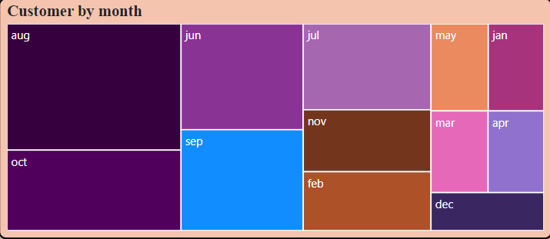
Monthly Interaction Analysis
Optimal Months for Campaigns:
Higher customer interactions occur in August, June, and October.
Impact of Interaction Timing :
Campaigns during months with fewer interactions could be improved for better customer engagement.
Subscription Rates by Month :
August has the highest subscription rate (18.25%), followed by June (10.23%) and October (8.42%).
.
Customer Engagement Trends:
Increased interactions in specific months suggest targeted outreach strategies can enhance campaign effectiveness.
Seasonal Variations in Engagement :
Understanding monthly interaction patterns can inform future marketing strategies and resource allocation

Slide 11
Communication Methods
83.88% of customers are contacted via cellular communication.
11.23% of customers are contacted via telephone.
Cellular communication appears to be the preferred and most effective method for reaching customers.
The "Unknown" contact type shows negligible subscription success.
Emphasizes the importance of valid contact details for effective communication.

Slide 12
Marital Status Insights
Housing Status Impact
Personal Loan Impact
Married Individuals Lead in Term Deposit Subscriptions (54.2%)
Shows strong financial commitment
Single and Divorced Individuals Make Up Smaller Groups
Different financial priorities and needs
Banks Can Use Demographics to Customize Products and Strategies
Marketing for Married Couples
Focus on security and long-term benefits
Tailored Products for Families
Offer joint term deposits
Promote through family channels
Use Data to Improve Marketing
Target married people at different life stages
Customers Without Housing Loans May Have More Disposable Income
More likely to subscribe to term deposits
Customer Breakdown
78.91% do not have a housing loan
21.09% have a housing loan
Tailored Campaigns for Better Results
Focus on customers without housing loans
Understanding Financial Status Is Key
Crucial for effective marketing strategies
Majority of Customers Do Not Have Personal Loans (93.97%)
Suggests potential financial flexibility for term deposit subscriptions
Most Customers Do Not Have Housing Loans (78.91%)
Indicates more disposable income for potential subscriptions
Opportunity for Targeted Marketing
Focus on customers with financial flexibility

Slide 13


Education Level Insights
Job Type Analysis
Education Levels Driving Subscriptions
Secondary and Tertiary Education contribute the most to subscriptions
Lower Subscription Rates
Customers with Primary or Unknown education levels have fewer subscriptions
Target Higher Education Levels
Focus on promoting term deposits to individuals with secondary and tertiary education
Tailored Marketing Strategies
Design campaigns that align with the educational backgrounds of potential subscribers
Top Job Categories for Subscriptions
Management, Retired, and Technicians lead in term deposit subscriptions
Low Subscriptions from Certain Jobs
Entrepreneurs and Unknown categories show significantly fewer subscriptions
Opportunity for Targeted Campaigns
Focus on job types with higher conversion rates for better results

Slide 14



